Slide 1

EVER HEALTH TECHNOLOGY PLAN
Presented by: Eagle Consulting

Slide 2
EAGLE CONSULTING
About Us
IT Consultancy and contracting agency for over 20 years
Founded in 1995
Goal of assisting businesses in staying up to date with the technological world around them
Acts as “Middle Man” for bringing close and personalized technology services to businesses in need

Slide 3
EAGLE CONSULTING
Mission
To stay up to date on current IT developments so that we may provide the most effective solution for your specific business needs
Aim to provide a fast, efficient, and most importantly effective IT answers
Save you time and money
Have a positive effect on the clientele you closely interact with

Slide 4
EAGLE CONSULTING
Vision
Facilitate an ever increasing amount of information technology solutions
Our desire is to constantly learn and develop new techniques
Aim is to be the best at understanding what makes your company special to provide the best information technology solution for you

Slide 5
EVER HEALTH
About Them
A chain of fitness centers operating nationwide 24/7
In 1973 two retired coaches, Henry Truman and Michael Hatch opened the first center in Columbus, Ohio
Prides itself not only on equipment and technology, but also an amazing atmosphere, a tradition of welcome, and unique experience found nowhere else
Their corporate location currently operates out of Columbus, Ohio

Slide 6
EVER HEALTH
Mission
Goal is to provide an environment that promotes accessibility to fitness equipment and knowledge to anyone that needs it
Aims to give you the tools necessary to start and maintain a healthy lifestyle
Maintaining a comfortable and welcoming experience

Slide 7
EVER HEALTH ORGANIZATIONAL CHART
Jason Zander
President & CEO
Lawrie Gaffney
CFO
Patrick lliott
VP Finance
Lola Jacobsen
VP Accounting
Olivier Renaud
Team Director
Spencer Lowe
Regional Manager
Of 5 Locations
Mike Danselio
Regional Manager
Of 5 Locations
Prashanth Desai
Regional Manager
Of 5 Locations
Szabolcs Vajda
Director of Human Resources
Jason Kozleski
VP Human Resources
Pat Coleman
VP Customer Svc
Gym Manager
Assistant Manager of Gym
HR representative

Slide 8
EVER HEALTH - 15 LOCATIONS
East Coast
Philadelphia, PA
Arlington, VA
Midwest
Cincinnati, OH
Detroit, MI
Columbus, OH
Milwaukee, WI
Chicago, IL
Dallas, TX
Houston, TX
Tucson, AZ
West Coast
Albuquerque, NM
Los Angeles, CA
San Francisco, CA
Denver, CO
Las Vegas, NV

Slide 9
THE PROBLEM
Ever Health website is outdated and lacks any type of client functionality
All information is stored locally
Customers must travel to the gym location to renew or cancel their membership
Major hassles that affect customer retention rate

Slide 10
THE COST
Ability to maintain and handle member information has become increasingly haphazard
Improper charges to cancelled or duplicate members cost both time and money to repair
In the past 2 years they have seen a 30% drop in customer membership renewal, resulting in a total loss of over $1,000,000
Customer satisfaction decreased 20% due to difficulties

Slide 11
THE SOLUTION
A centralized Database:
  Shared across all gym locations
  With all appropriate documentation
A redesigned and fully functional website:
  Add functionality that allows customers to create, renew, update, or cancel their membership
  Connected directly to the database

Slide 12
THE SOLUTION
A Front end Interface:
  Properly documented and useable by all employees
  Capable of pulling and updating information from the database
An accounting system

Slide 13
THE SOLUTION
Database, website, and network systems monitoring to ensure functionality
Develop and streamline system manual/training to ensure staff learn and understand the system
Cost/Benefit Analysis
Back up and Disaster Recovery plan

Slide 14
PROJECT COMPLETION
Expected completion date: December 13th, 2016
Upon Completion of this project, we expect to see:
  A 50% increase in overall customer satisfaction
  An 80% increase in customer retention
  Potential to see increased revenue between $500,000 - $800,000
  A 10% increase in Membership sign ups yearly; 2,000 new customers bringing in $200,000 annually
  A 10% increase in employee efficiency

Slide 15
Project Team Roles and Responsibilities
Roney Whonshevins Project Lead
Jacob Wagner Software Developer
Adan Maxamed Software Developer
James Leahy Web Developer
Guy Banaga Network Engineer
Andrew Butts Network Engineer

Slide 16
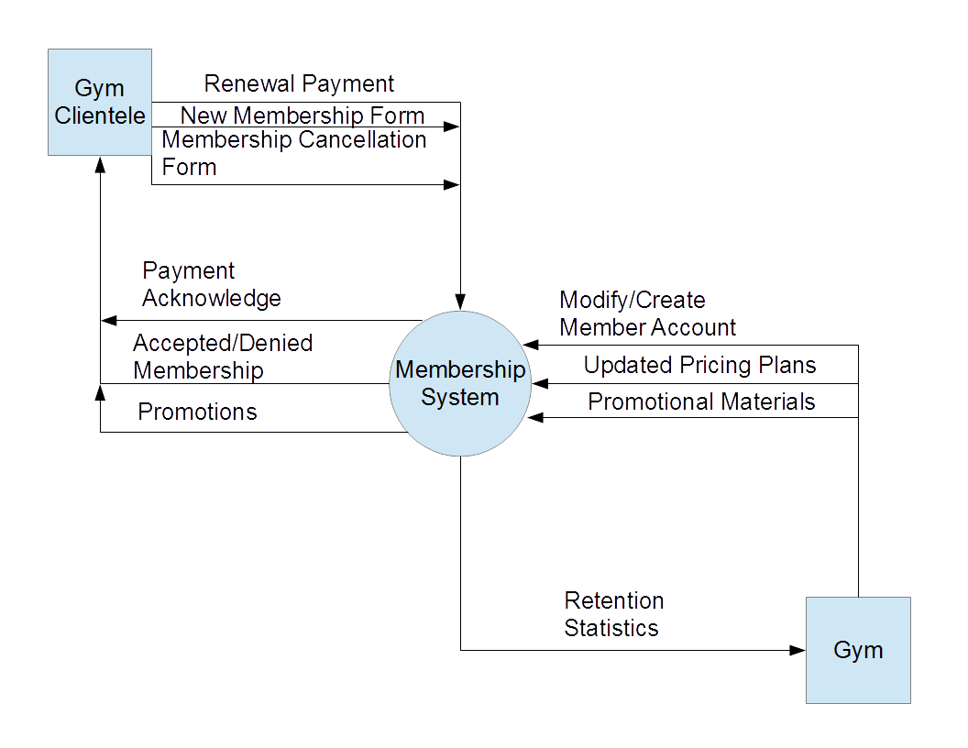
IMPLEMENTED SYSTEM
Gym Clientele
Database
Gym Location

Slide 17
PROJECT TIMELINE
Eagles Consulting
10/31/2016
2016
09/11
09/18
09/25
10/02
10/09
10/16
10/23
10/30
2016
5 days
Today
System Design
9/13/16 - 9/19/16
5 days
Creation of Financial System
9/20/16 - 9/26/16
5 days
Creation of Database Sytem
9/27/16 - 10/3/16
5 days
Excel Integration
10/4/16 - 10/10/16
5 days
Business Documents
10/11/16 - 10/17/16
5 days
Advertising Materials
10/18/16 - 10/24/16
5 days
Website Development
10/25/16 - 10/31/16

Slide 18
5 days
Report Creation
11/1/16 - 11/7/16
5 days
System Testing
11/8/16 - 11/14/16
5 days
Training
11/15/16 - 11/21/16
5 days
System Development Part 1
11/22/16 - 11/28/16
5 days
System Development Part 2
11/29/16 - 12/5/16
5 days
System Development Part 3
12/6/16 - 12/12/16
1 day
Presentation
12/13/16
Eagles Consulting
12/12/2016
2016
10/30
11/06
11/13
11/20
11/27
12/04
12/11
2016
Today

Slide 19
Back-End Program

Slide 20


Slide 21
Network Infrastructure Proposal

Slide 22
Original Network Infrastructure
old infrastructure
archaic equipment

Slide 23
Proposed Network Infrastructure
install DC in all 15 current locations.
hybrid network
With the new network we added modern equipment
enhanced security.

Slide 24
Installing Ever Health Domain Controller
Running dcpromo on Active Directory (AD)
Choosing a deployment configuration
Choosing the FQDN
Adopting the Windows Server 2008 R2 or later
Creating External OU Structure
Creating Internal OU Structure
Creating groups and passwords policies

Slide 25
Naming Standards
Object | Standard | Example
Windows Server | TYPE-SITE-DC# | WS-ARL-DC1
Exchange Server | TYPE-SITE-# | EXC-ARL-1
* Additional Server Objects Added To Sites | TYPE-SITE-# (Number incremented by adding incrementing Alphabetical notation. With “A” indicating the first addition server object.) | EXC-ARL-1A

Slide 26
IP Addressing and Network Subnetting
Locations | Network ID | From | To | Broadcast ID
Columbus | 10.0.0.0 | 10.0.0.1 | 10.0.1.254 | 10.0.1.255
Reserved | 10.0.2.0 | 10.0.2.1 | 10.0.3.254 | 10.0.3.255
Reserved | 10.0.4.0 | 10.0.4.1 | 10.0.5.254 | 10.0.5.255
Reserved | 10.0.6.0 | 10.0.6.1 | 10.0.7.254 | 10.0.7.255
Reserved | 10.0.8.0 | 10.0.8.1 | 10.0.9.254 | 10.0.9.255

Slide 27
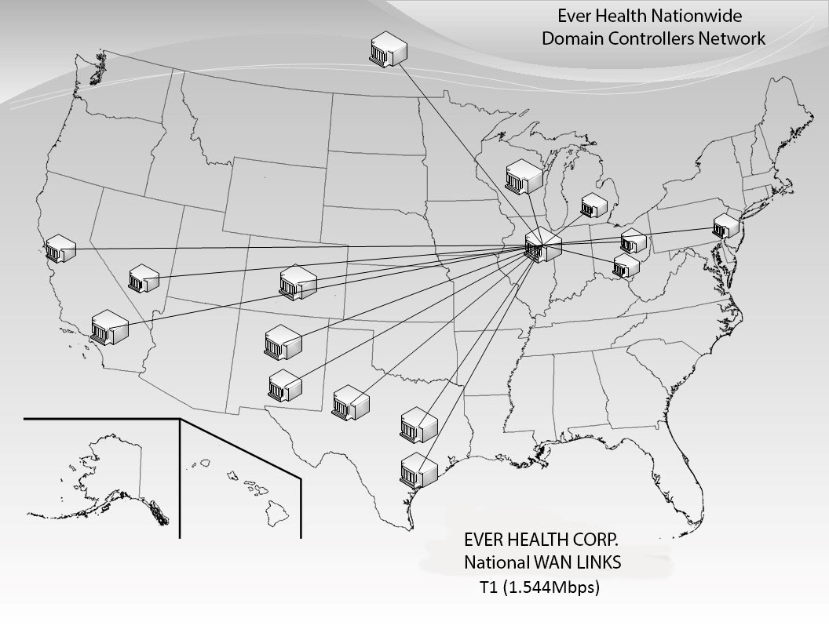
National Footprint

Slide 28
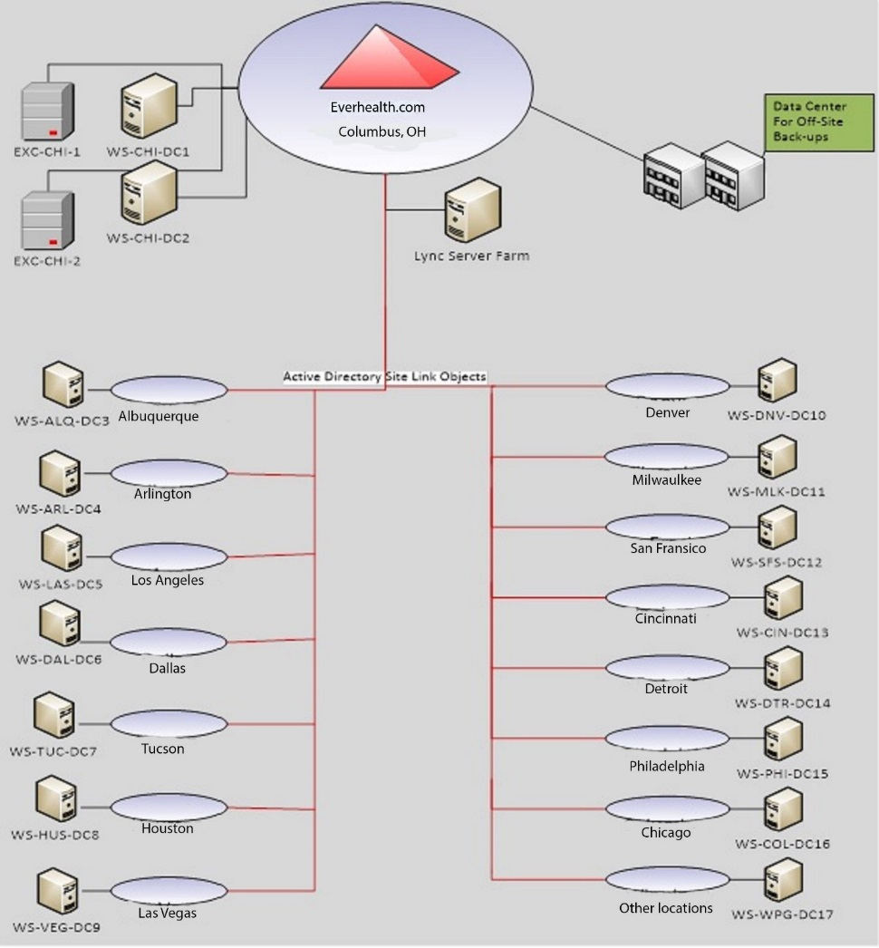
Everhealth Single Domain Topology

Slide 29
Brief Summary on Security In Place
Zero-clients
network monitoring software
SNORT
Equipment in locked/cooled room.
backup servers
proxy server
Extra Equipment

Slide 30
Proposed Equipment/software Costs
Equipment upgrades are 521480.84
$7999.86 for software costs.
$40,000 through Rackspace and Microsoft Azure

Slide 31
11/08/16 New Equipment Ledger
Equipment | Equipment ID | Price Per | Item Count | Price Total
Cisco 8861 Gigabit IP Phone | CP-8861-K9 | 265 | 171 | 45315
10ZiG V1200-P Zero Client | V1200-P | 317.9 | 341 | 108403.9
Cisco 1941 Integrated wired router | Cisco1941/k9 | 471.94 | 16 | 7551.04
Cisco Catalyst WS-C2960S-24TS-L Switch | WS-C2960S-24TS-L | 850 | 71 | 60350
Shielded cat5e gray Ethernet cable box | sct5egec | 136.21 | 93 | 12667.53
Unshielded cat5e Red Ethernet Cable box | usct5egec | 70.07 | 61 | 4274.27
Fortinet FortiGate-900D | FG-900D NGFW UTM | 14000 | 1 | 14000
Fortinet FortiGate-90D | FG-90D | 758 | 15 | 11370
HP® LaserJet Enterprise M604N | M604N | 594.99 | 90 | 53549.1
Servers | Servers | 4000 | 51 | 204000
Total |  |  |  | 521480.84

Slide 32
Q & A

Slide 33
Thank You!

